Slide 1
Cyclistic Bikeshare
Converting Casual Riders to Members
Robert Wittstock
5/2/2024

Slide 2
Overview
Stakeholders
Executive Team
Director of Marketing
Marketing Analytics Team
Business Task
Analyze how annual members and casual riders use Cyclistic bikes differently and provide three recommendations to influence Cyclistic’s digital media marketing strategy to convert casual riders into members.
Project outline
Data Overview, Processing, and Cleaning
Data Analysis, Key Findings, and Summary
Recommendations

Slide 3
Data Overview, Cleaning, and Processing
Overview
Multiple CSV files containing Chicago customer ride data for TTM ending Sept 2021
5,136,261 Total Records, and 13 Fields:
ride_id, rideable_type, started_at, ended_at, start_station_name/id, end_station_name/id, start_lat, start_lng, end_lat, end_lng, member_casual
Cleaning
Cleaning and Transformation done using R on Kaggle
Cleaning includes: cleaning station names, bike types, coordinates
Removal of duplicates, incomplete records, and ride duration outliers
Processing
Combined CSV files into one large file
Added calculated fields, including duration, year, month, weekday/weekend and path between stations.
Removed unnecessary columns and uploaded CSV to Tableau.

Slide 4
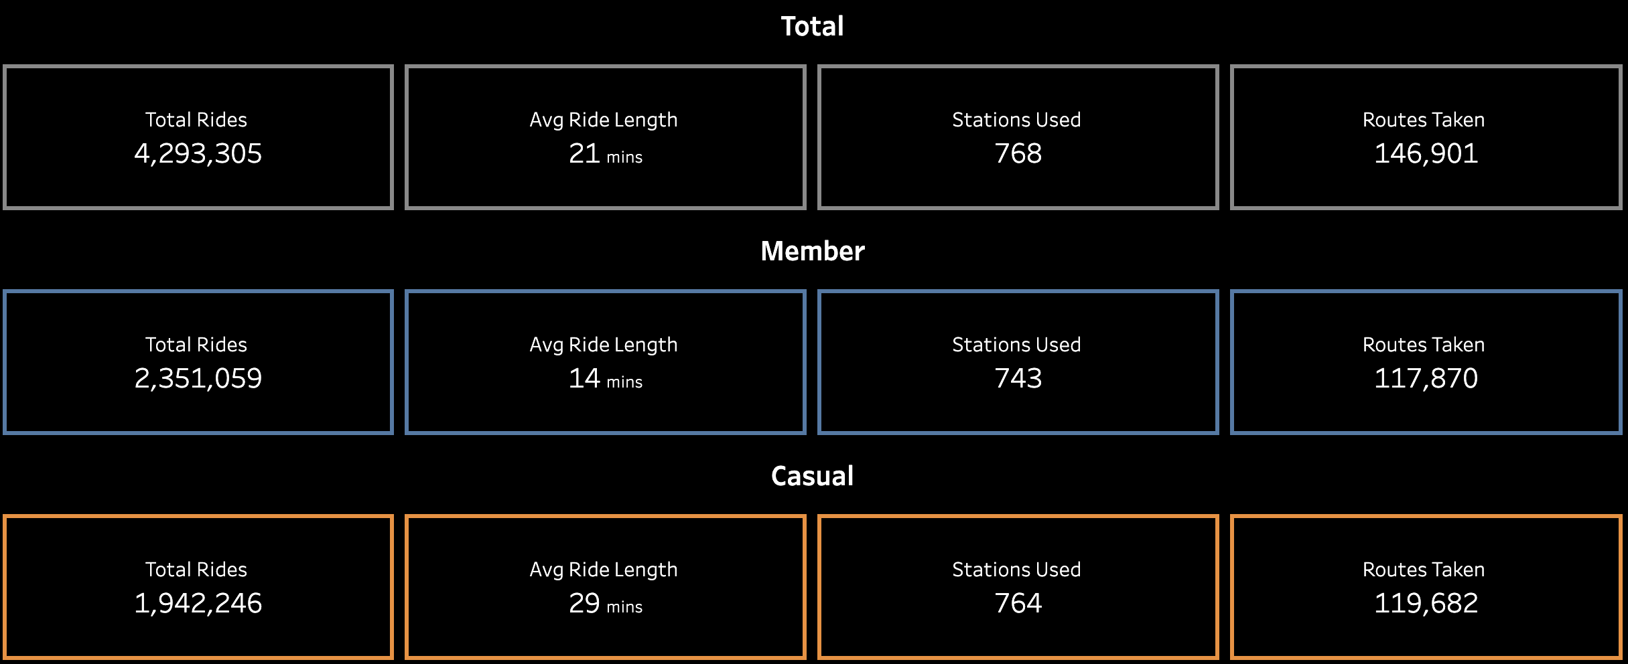
High Level Analysis

Slide 5
High Level Analysis
Average ride length almost double for casual riders

Slide 6

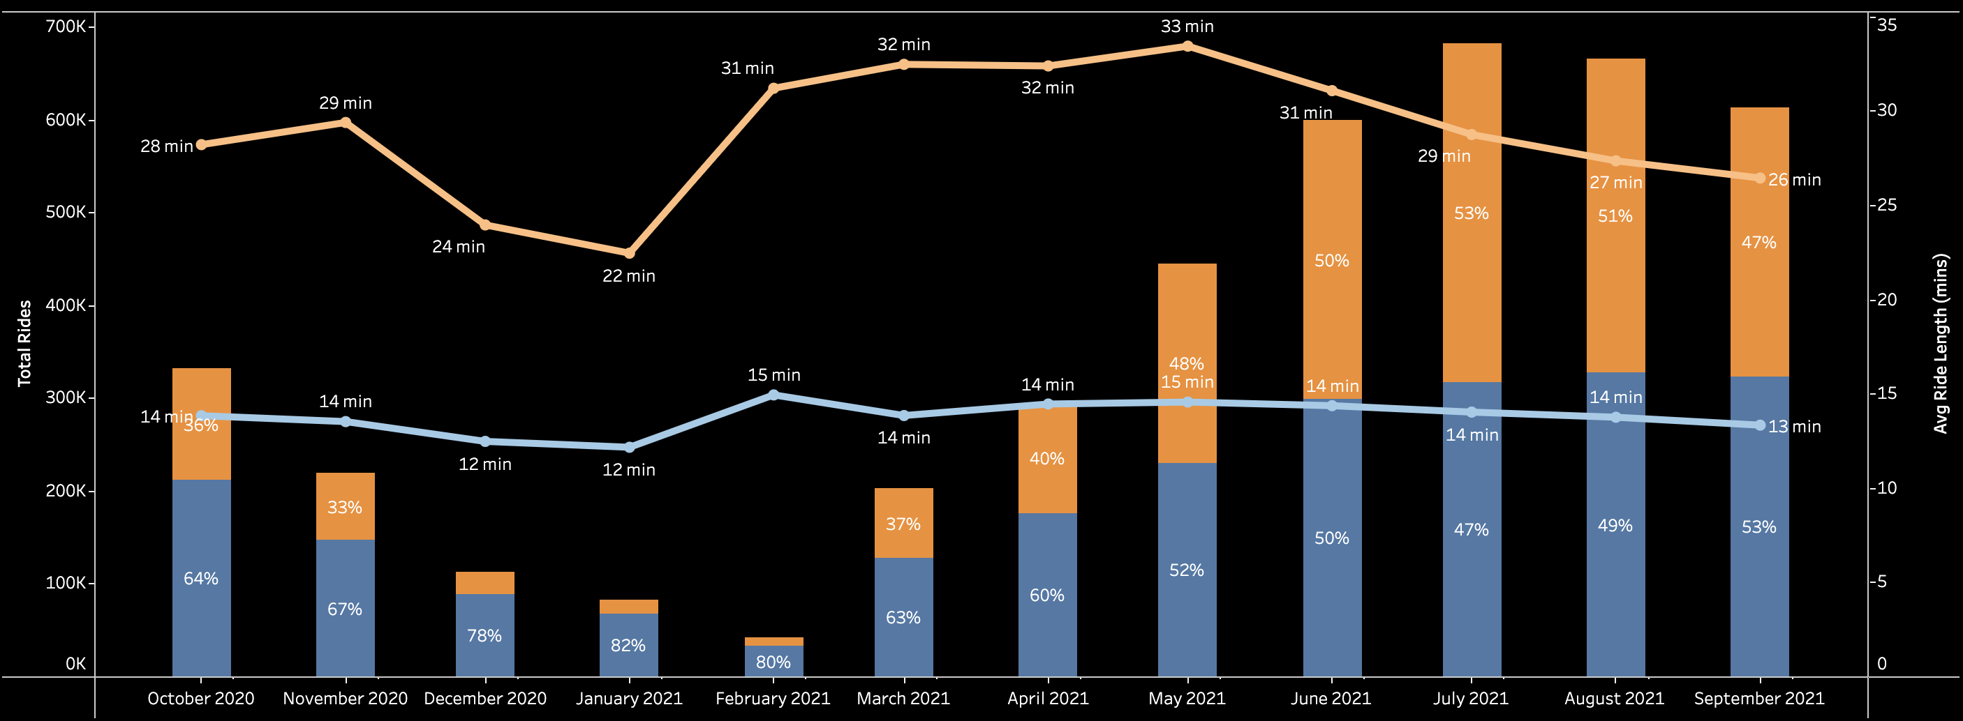
Monthly Trends

Slide 7
Monthly Trends
Ridership drops significantly in winter months
More casual riders in summer months

Slide 8
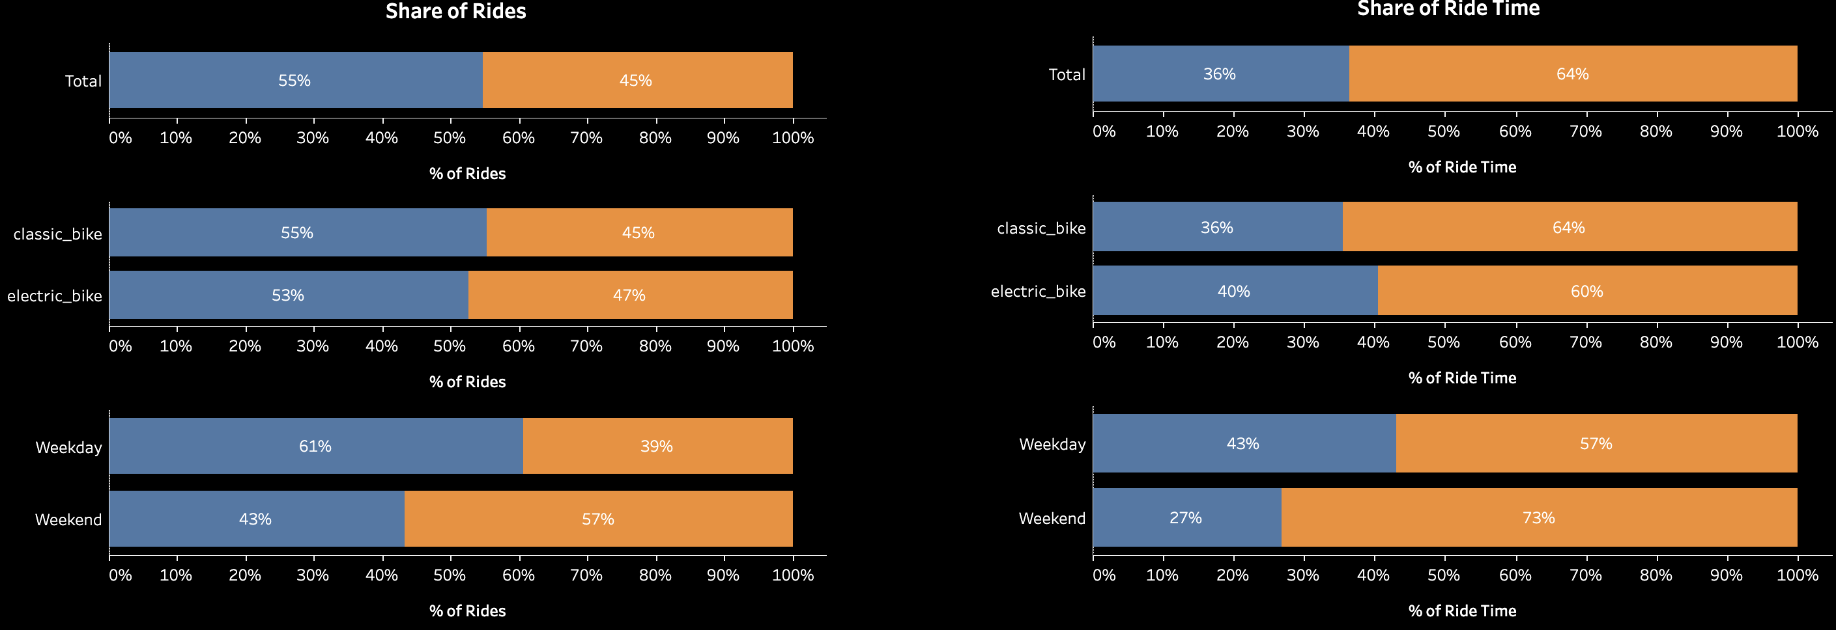
Share of Rides & Ride Time

Slide 9
Share of Rides & Ride Time
Usage higher on weekends for casual riders and higher on weekdays for members.

Slide 10
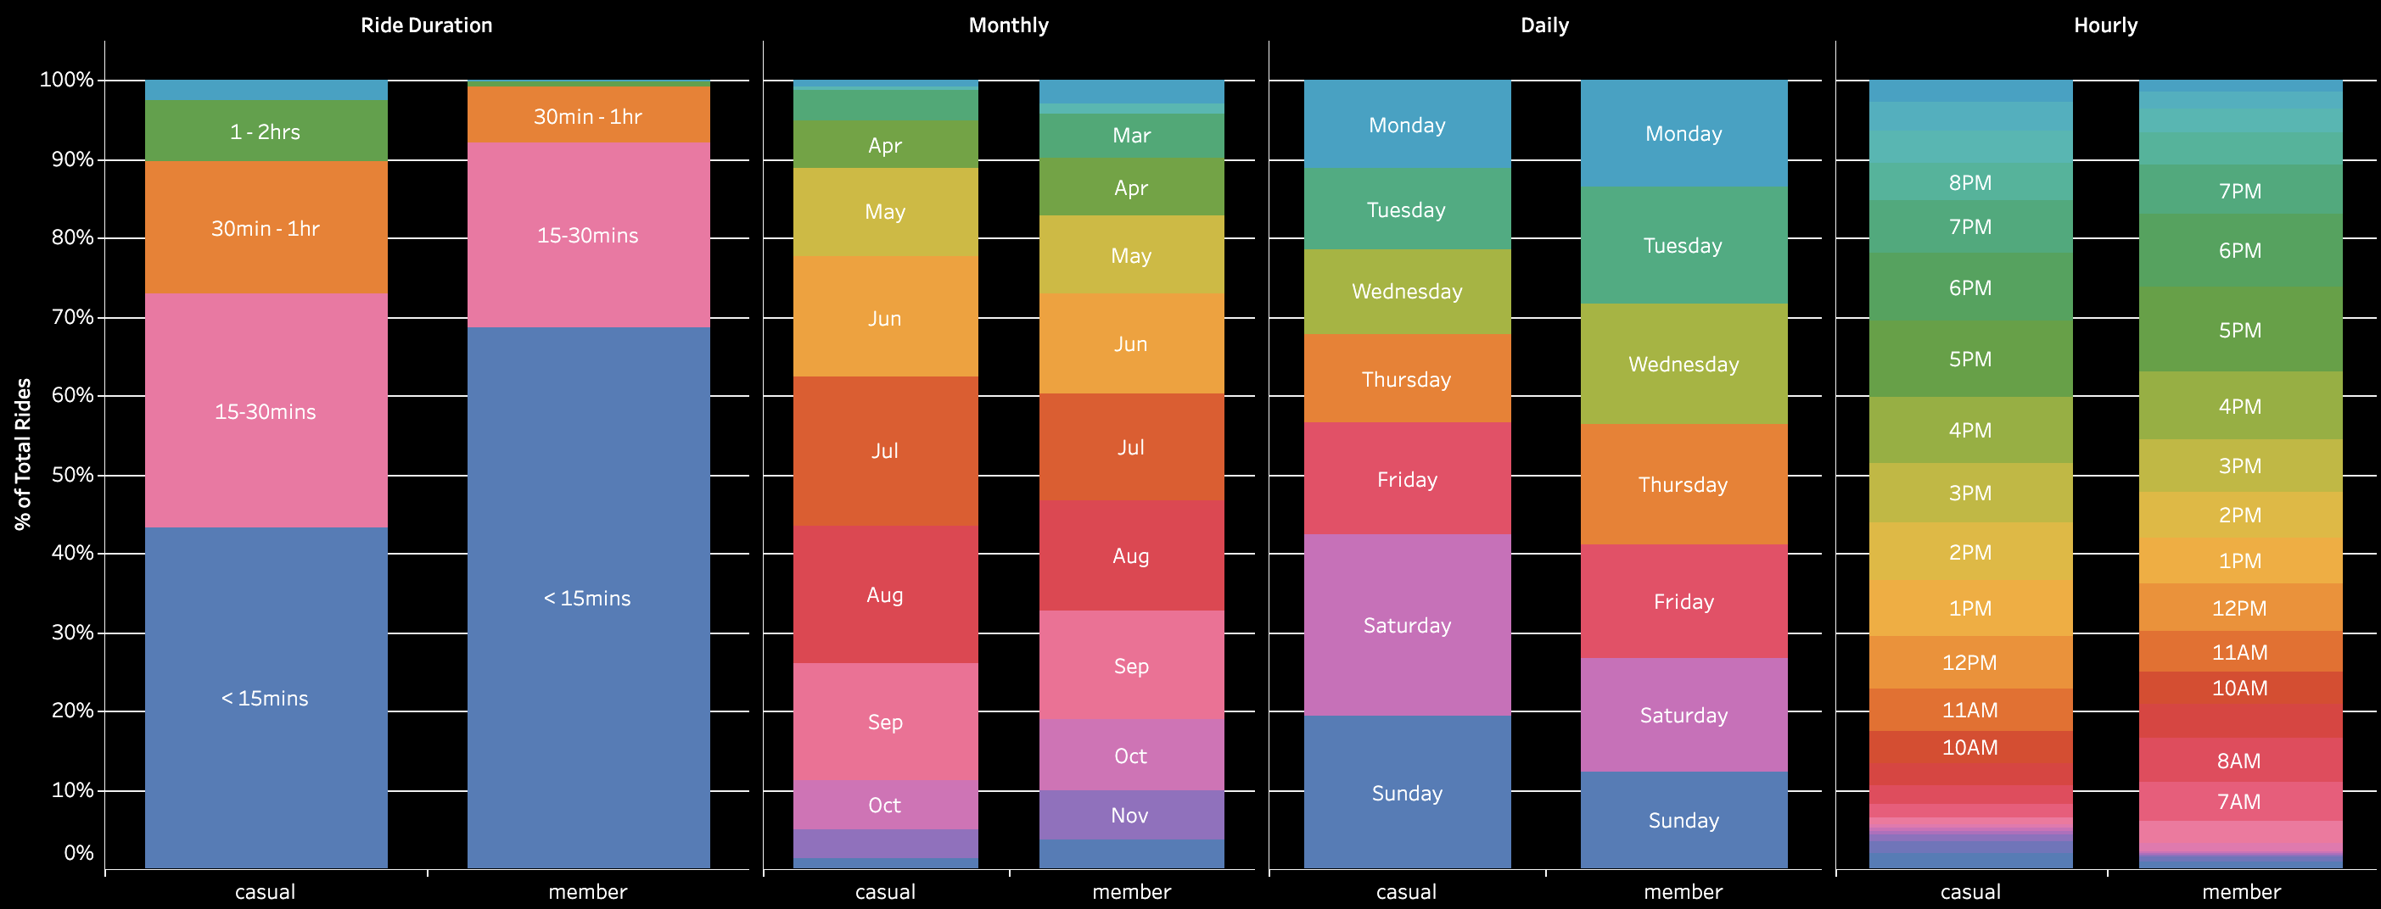
Time Segmentation Analysis

Slide 11
Time Segmentation Analysis
Almost 70% of member rides are under 15 minutes.
Members ride more during morning commute hours

Slide 12
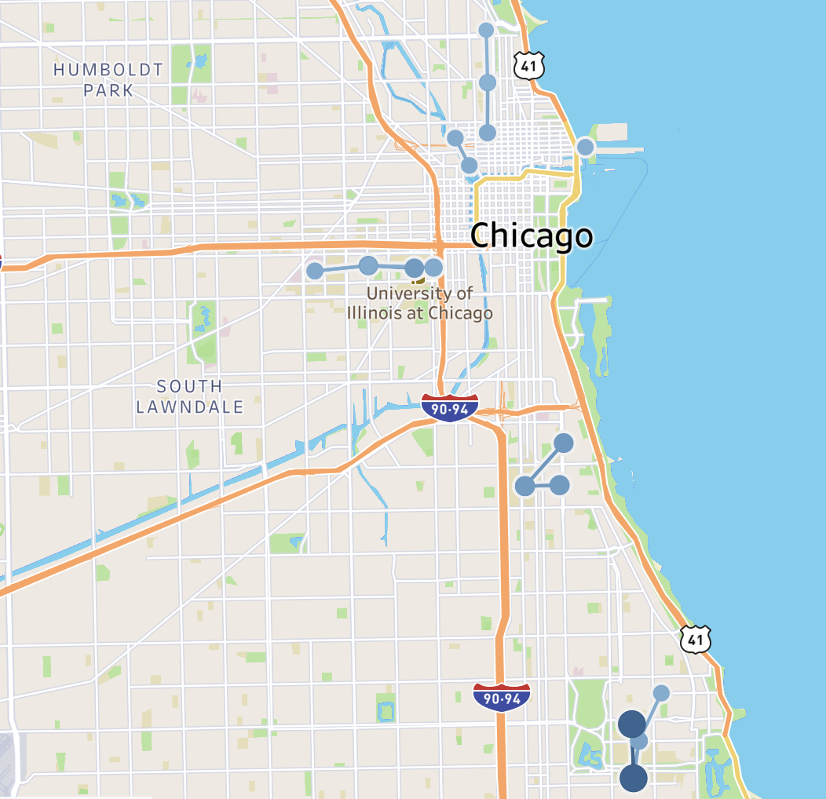
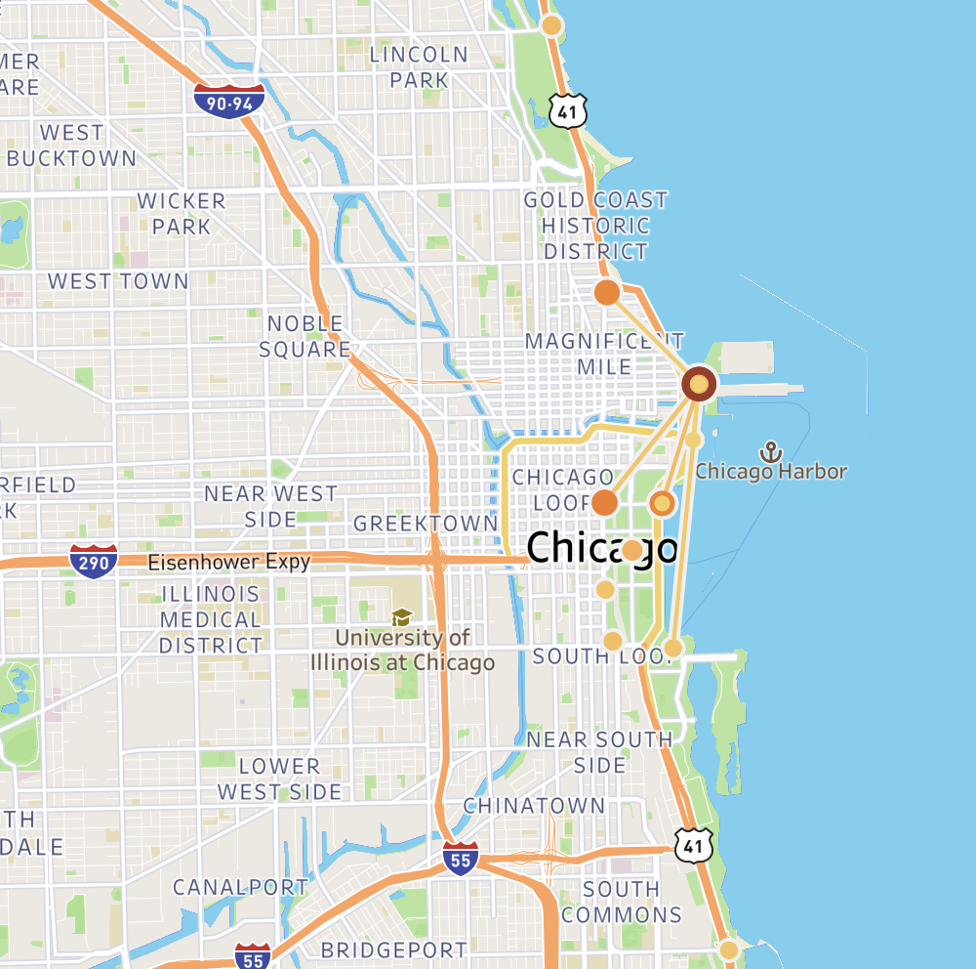
Top 20 routes
Members
Casual

Slide 13
Top 20 routes
Members
Casual
Tourist and leisure area
College Campuses

Slide 14
Summary
Member | Common | Casual
Ride more in University Areas | Wide Variety of Stations and Routes | Ride more in tourist and leisure areas
Less seasonal | Seasonal ridership | More seasonal
Shorter average ride duration | Majority of rides under 30 minutes | Longer average ride duration
Ride more during commuter hours on weekdays | Ride often in afternoons and evenings | Ride less in the mornings and more late-night

Slide 15
Recommendations

Slide 16

Target College Students
As shown earlier, top member stations are located primarily around universities. Students are strong adopters of the bikeshare service.
There are many riders in the college areas that are casual. Converting those casual riders could help Cyclistic gain a larger share of college student members.
Chicago has more than 200,000 college students, with a market share increase of 10% and an hypothetical average rides per month per member of 10 (once every other weekday), this could increase total rides by 2,400,000 an increase of over 50% to total rides.

Slide 17
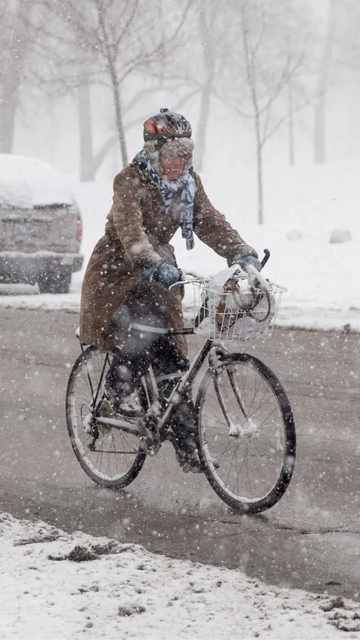
Seasonal Marketing
Marketing to convert casual riders during winter months could prove to be highly ineffective, since less than 10% of rides take place between Dec-Feb.
Spending less on Marketing during these months could save the company a significant amount of money and improve the company’s overall customer acquisition cost.
Moreover, this opens up budget to spend more to convert casual riders during opportunistic seasons, such as summer and back to school months.

Slide 18
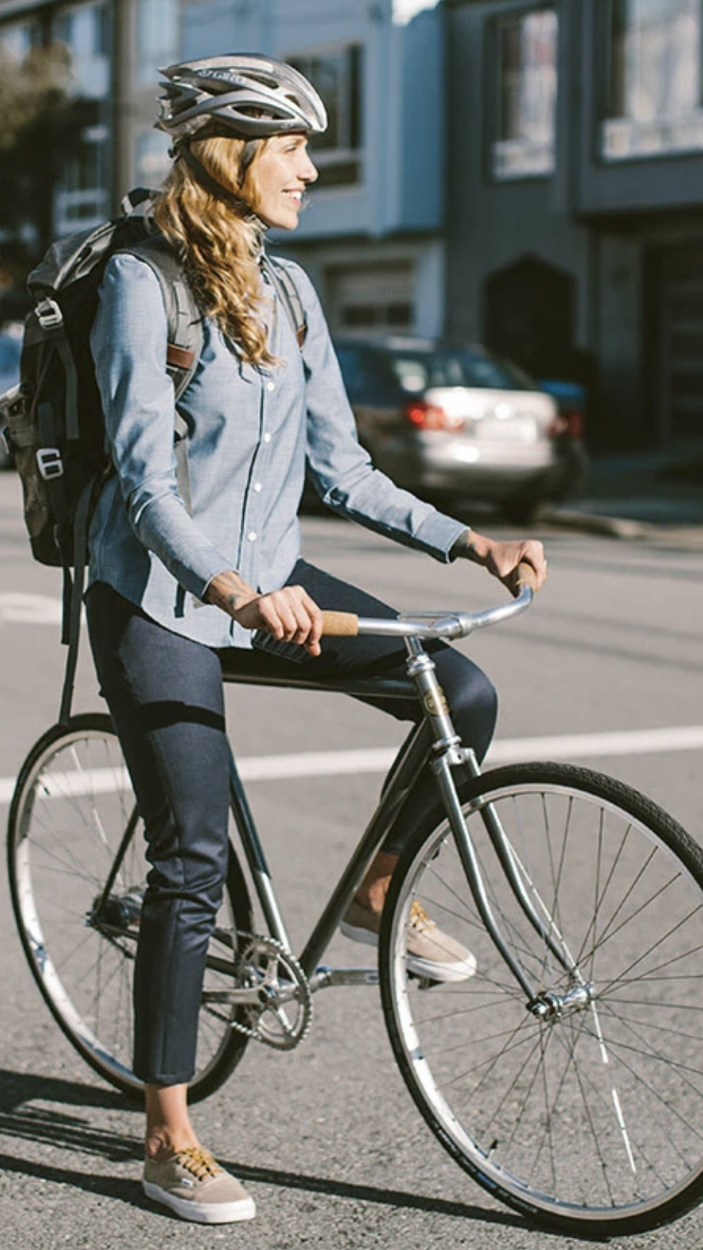
Ride Duration and Weekday Targeting
Since there is a long tail of stations used by riders, it could be more efficient to target casual riders that fit the duration and time of day profile as member riders
This would include casual riders that ride during the week and take short rides, under 15 minutes.
This target audience would amount to around 40% of casual riders. Converting 25% of those riders would increase member ridership by almost 10%.

Slide 19
Questions?

